Slide 1
Advances in Reinforcement Learning Inspired by Statistical Mechanics
J. Adamczyk
Advisor: Prof. Rahul V. Kulkarni
Collaborators: Stas Tiomkin, Volodymyr Makarenko, Argenis Arriojas, Di Luo

Slide 2
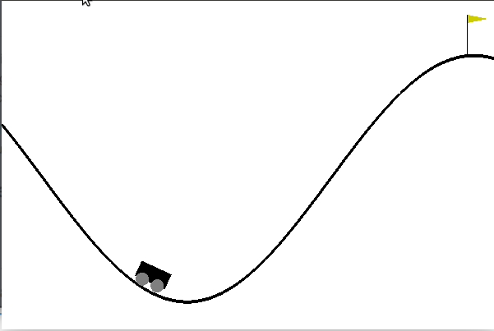
Reinforcing Rewards
Mountain-Car environment
Reinforcement Learning (RL) is a method of solving sequential decision-making problems by interacting
Basic Idea:
An agent interacts with the environment, by taking actions
Positive behaviors are reinforced relative to undesirable behaviors
Reinforcement is implemented via a reward function
The agent should learn to maximize rewards received
Specifically, average reward over (infinitely) long trajectories

Slide 3
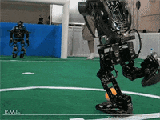
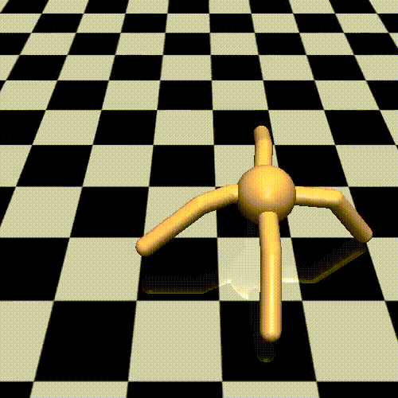
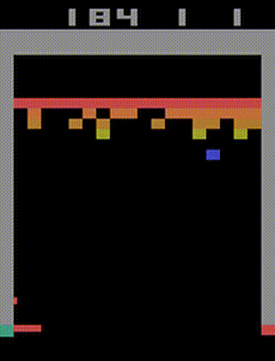
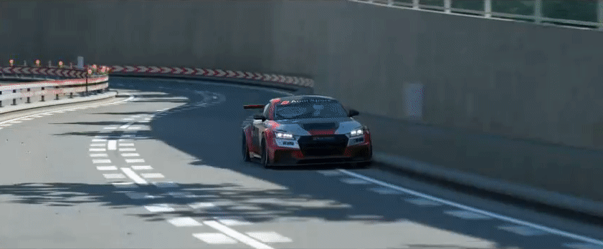

Slide 4
Bountiful Bridge
Statistical Physics
Free Energy
Ground State
Correlation Scales
Hamiltonian MCMC
Tightening Bounds
Reinforcement Learning
Value Functions
Max Reward-Rate
Mixing Time
Sampling Methods
New Algorithms

Slide 5
Fresh Findings
New proof and perspective of Policy Improvement (PI)
New algorithm for MaxEnt RL by bounding the Q function [1]
Ground-state formulation of RL problem
Extension of Donsker-Varadhan formula to value functions [2]
Average-Reward Algorithms [3]
[1]: “Boosting Soft Q Learning by Bounding”, Under review at RLC, 2024
[2]: “Eigenvector Based Average-Reward Learning” In Preparation for JMLR
[3]: “Off-Policy Algorithms for Entropy-Regularized Average-Reward RL”, Under review at NeurIPS 2024

Slide 6
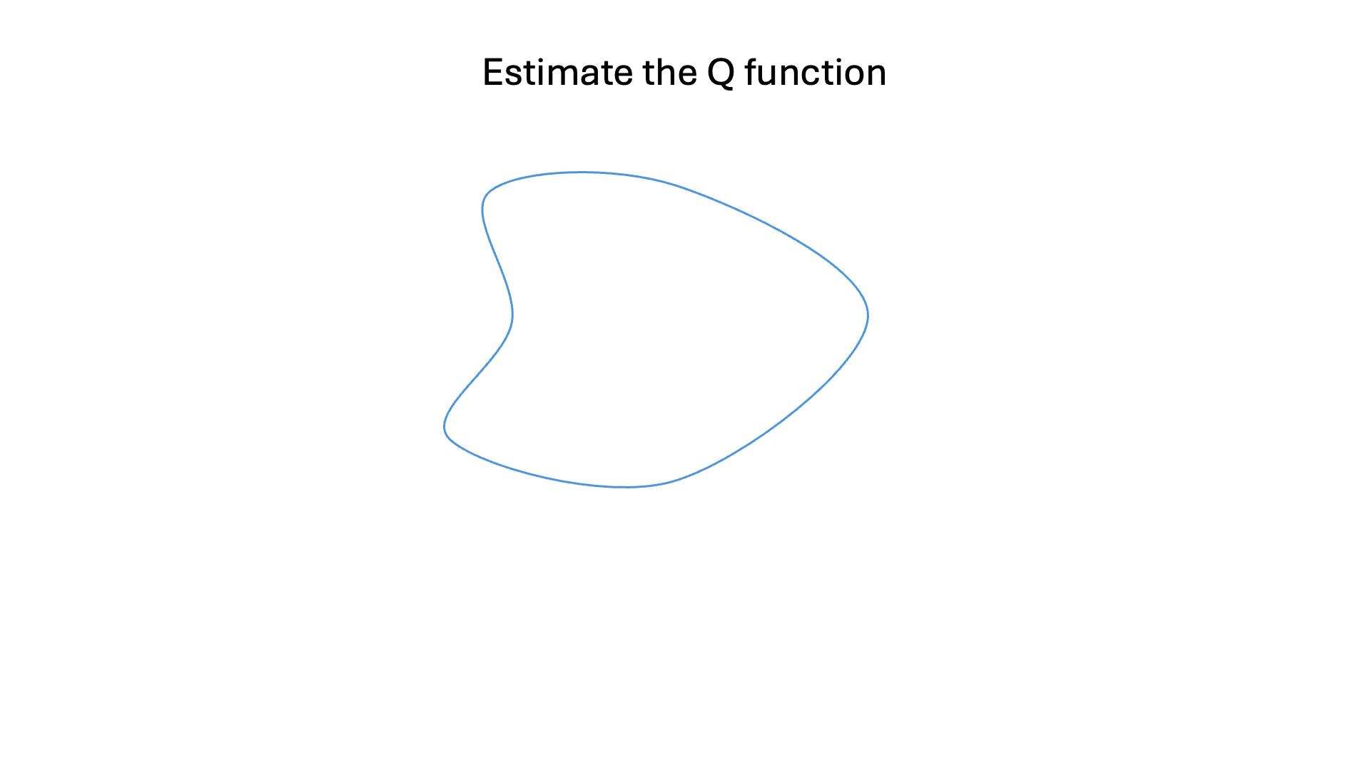
Bounds Abound
The optimal Q function can be bounded from arbitrary guess
Generate Bounds on Q*
LB, UB
Clip the guess
of Q*
Better guess

Slide 7
Friendly Free Energy
The free energy (Q-func) satisfies a variational form (for arb. $p$):
$$F≐−\frac{1}{β}log \sum_{x}{{p_{0}\left(x\right)e}^{−βE\left(x\right)}}≤𝔼_{p}\{E+β^{−1}D_{KL}\left(p | \left|p_{0}\right)\right\}≐F_{p}$$
How big is the gap between true free energy ($F$) and variational guess ($F_{p}$)?
$$F=F_{p}−D_{KL}(p|p^{∗})$$
$$Q^{∗}\left(s,a\right)=Q^{π}\left(s,a\right)−D_{KL}(π|π^{∗})$$
$$p^{∗}(x)∝{p_{0}(x)e}^{−βE(x)}$$

Slide 8
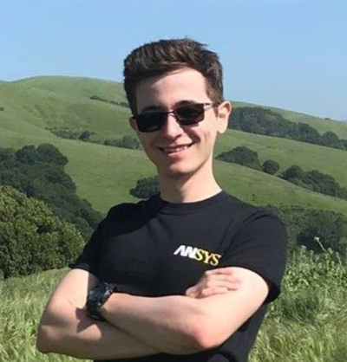
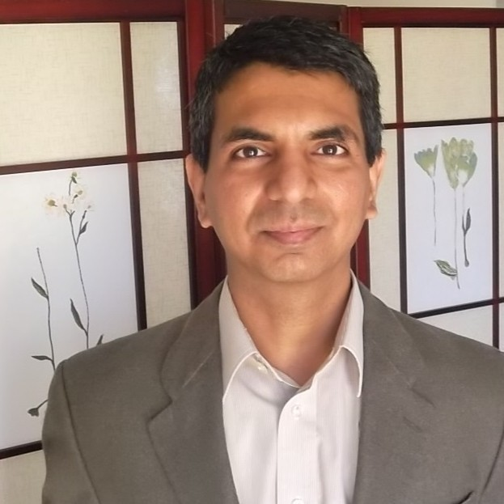
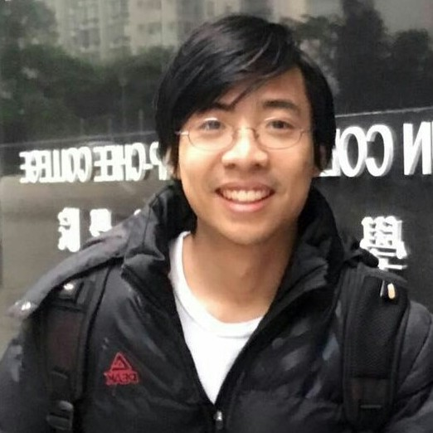
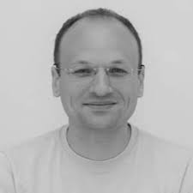
Thank you!
Rahul Kulkarni
Argenis Arriojas
Di Luo
Stas Tiomkin
Vlad Makarenko

